Slide 1
Creating Space for Mental Health at CUWIP
Andrea J. Welsh
Georgia Institute of Technology
awelsh8@gatech.edu
@theoreticalwzrd

Slide 2
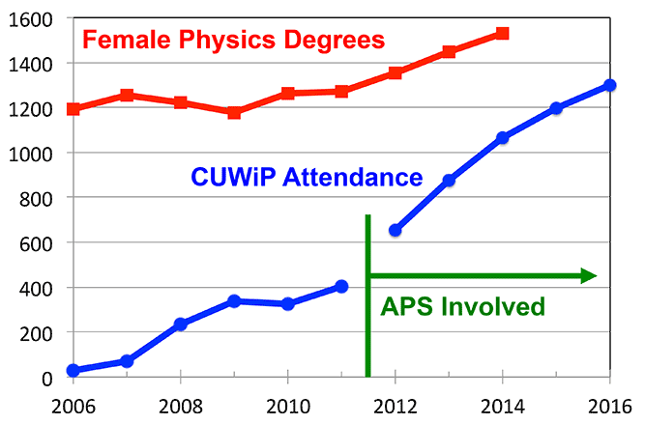
Conferences for Undergraduate Women in Physics (CUWIP)
Organized through APS with a national committee
Multiple regional sites host them simultaneously
Reaches most women who get bachelor degrees in physics in the US
Consists of multiple “breakout sessions” that students can choose topics to attend
Sessions tend to be small groups 5-30 students
Sessions often range from different physics areas, physics careers, and diversity discussions

Slide 3
Motivation: My first CUWIP in 2009- Yale University
Had a history of depression & anxiety (& ADHD?)
Was not getting treatment
Spent third of the conference not able to concentrate on the talks
Spent third anxious about not following along and trying to tALK with PeoplE??
Spent third feeling bad for not talking with people and not being able to pay attention thinking that none of the women speaking probably had these issues, and because I did, I would never get to their point
Didn’t go back until 2015 (before which, I started regularly doing group/individual counseling and had been on anti-depressants/anti-anxiety meds)

Slide 4
2016: Chairing a CUWIP Conference
What would 2009 me wish I saw?
Our conference website FAQ section:
Response: National committee found it unique, graduate students contacted me saying they were grateful and thanked me, undergraduates brought up their mental heal concerns in their applications

Slide 5
Depression and Anxiety: Dealing with Mental Health While in School
Would people be interested?
Yes! About 30 students signed up in pre-conference survey, ~30 attended (standing room only) of ~200 attendees even with 10 workshop options available
How would I run it?
GT Counseling Center representative will talk about mental health basics
Personal self-care tips (eating right, exercising, scheduling breaks, seeing a doctor, medication)
Resources that can be found on and off campus
What you can do if it gets overwhelming (drop a class, switch to pass/fail, incomplete, take a semester off)
I would also speak a little about my mental health
What are some lasting effects?
Students felt more open talking about it, not a “taboo” --> more likely to get seek out resources
Other CUWIPs took it back to their conferences

Slide 6
2017 CUWIP Sites with a Mental Health Workshop
Rice University: “Mental Health: Handling Stress”
Representative from Rice Counseling Center held a presentation
Student’s sharing experiences
“…the knowledge that I am not alone. Everyone there really came together to offer advice, support, and affirmation that stress, depression, and anxiety are real challenges that we face as undergraduates in physics”
McMaster University:
run by “Working Improv”
Destress techniques, Thai Chi
One of the most popular workshops, 30 signed up, even more attended
Some students critical of lack of resources and discussion of serious mental health concerns
Princeton University: “Mental Health”
University of Colorado Boulder: “Managing Mental Health”
In addition to these sites, Virginia Tech and Montana State all added the FAQ

Slide 7
Other Conferences:
6th Annual oSTEM Conference in Denver, Colorado, 2016:

Slide 8
What Else Can be Done?
More open conversations about mental health in an our of the classroom (statements on syllabi, websites, etc)
Make resources, especially those on campus, easily available students
Hold workshops for students through campus counseling centers
Make educators more aware about the effects of mental health, possibly through training
Other suggestions?

Slide 9
Simonetta Luiti
Organized session on working with Autism
AAS, Working Group on Accessibility and Disabilities
JED Foundation, “protect emotional health and prevent suicide for our nation’s teens and young adults”

Slide 10
Resources
National Suicide Prevention Lifeline 1 800 273 8255
Campus counseling centers (often free, but in high demand, check available options)
Local off campus centers (often cost $)
Suicide Prevention Resource Center
Online training courses
JED Foundation
ULifeline –online resource for college mental health
National Alliance on Mental Illness

